Slide 1

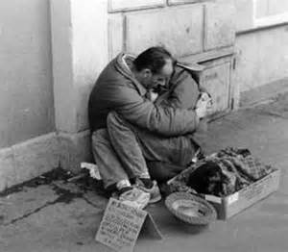

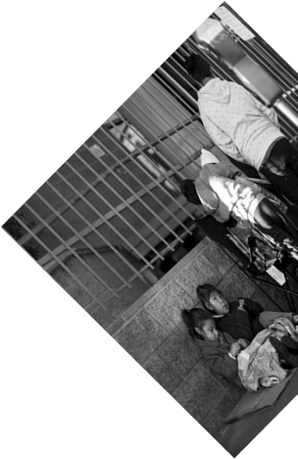

City of Los Angeles
Homeless Project
Mi Su
Tzu-Yi Huang
Yin Chen
Shuyi Tao
ChinKai Huang
Notes:
Good afternoon, today our group will report to you our findings on city of LA home。。

Slide 2
01
Background and Issue Identified
02
Data Visualization and Analysis
-- LA, the Capital of Homelessness
-- Issue Identified
-- Five Datasets Used
-- Homeless Distribution Analysis
-- Shelter Distribution Analysis
-- Crime Analysis
C
ONTENT
03
Predictions
-- Predict the Trend
-- Predict 2018 Top 10 Homeless Community
-- Predict 2018 Number of Crime
-- Predict 2018 Top 10 Crime Community

Slide 3
01
Background and Issue Identified
01
-- LA, the capital of homelessness
-- Issue identified
-- Five datasets used

Slide 4
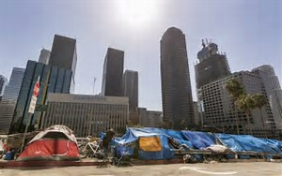

95%
The homeless capital of U.S
Los Angeles reported the largest number of chronically homeless people in the nation for continuous two years in 2016.
Of them live in outdoors, in cars, tents and encampments,
The number of sheltered homeless was nearly 13000 in 2006
Notes:
The phenomenon of homelessness has been one of the most serious problems in LA for many years, and people even called LA the homless capital of America

Slide 5

Issue Identified
Our goal
As the city is allocating the resources, the challenge facing is how to prioritize the area of high concentration with homelessness as well as with high danger and health risk. So, this is what our project aims to solve
.
Notes:
As the city is allocating resources to the homeless, the challenging it facing now is how to identify the area of high concentration with homelessness as well as with high danger and health risk, so , this is what our project aims to solve.

Slide 6
LAHSA PIT count geospatial data
Shelters
Crime
Count 2017 results by census tract
311 calls
Data Description—the Dataset Used

Slide 7
02
Data Visualization and Analysis
02
-- Homeless Distribution Analysis
-- Shelter Allocation Analysis
-- Crime Analysis
Notes:
Now, let’s see how we do our data visualization and analysis

Slide 8

Homeless Distribution Analysis

Slide 9

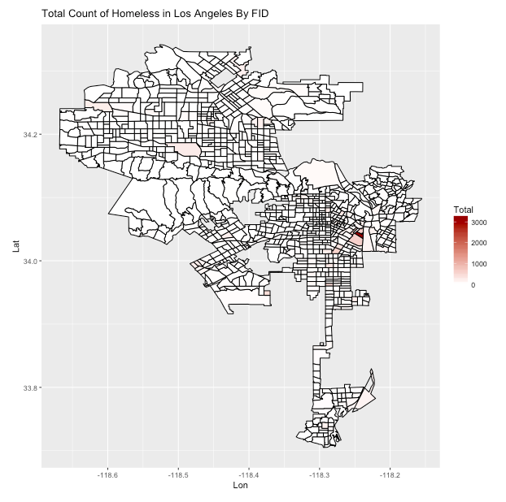
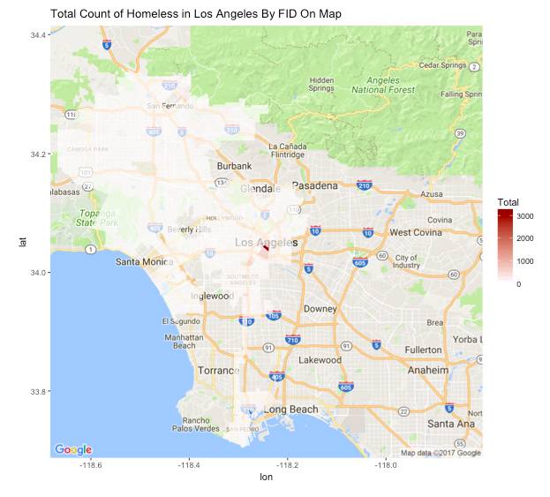
Total Count of Homeless Distribution
Notes:
Based on PIT count data, we draw a chart about homeless distribution as shown in the left .We can see the homeless are mainly concentrated in the red area, to make it more illustrated, we put this chart on google map, and we find that red area is just downtown, which also matches the fact in LA

Slide 10
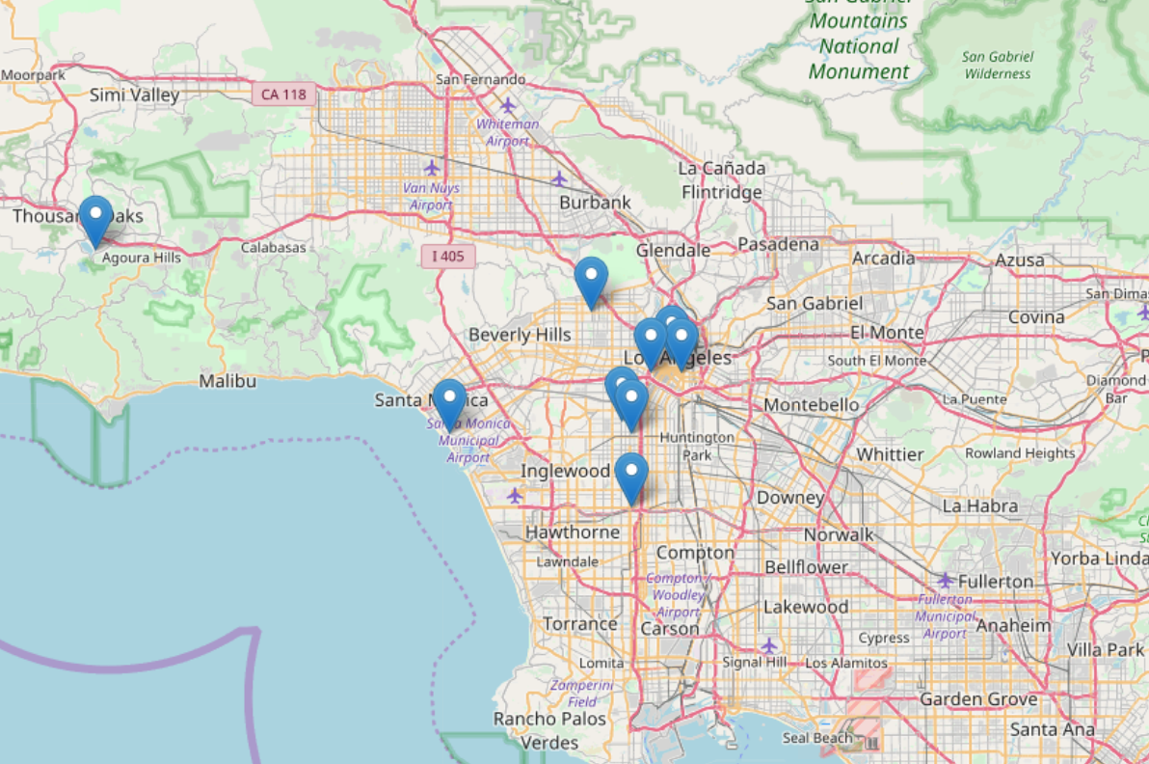
2017 Top 10 Homeless Community
Notes:
Based on 2017 count data, we positioned the community with top 10 number of homeless people on map, most of which are also concentrated in downtown as the map shows

Slide 11
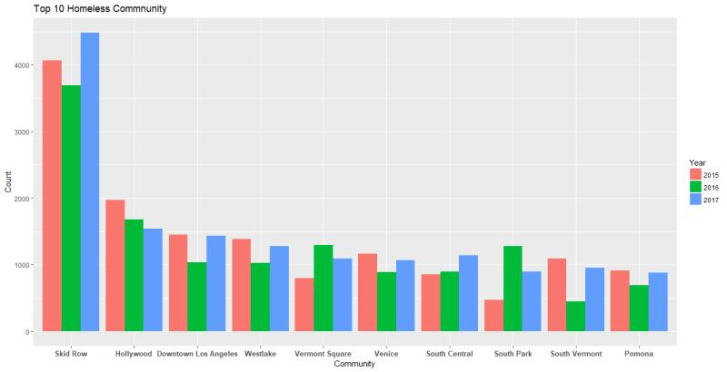

Top 10 Homeless Community
Notes:
Here is the bar chart showing the number of homeless people in Top 10 community in recent 3 years. The X-axis is the name of community, the Y-axis is the count of homeless people. We can see the number of homeless people almost kept stable in these years .While the community Skid Row has the largest number of homeless people , far more than other communities, which is our targeted rescuing area. Now Jaffny will present to you shelter allocation analysis

Slide 12
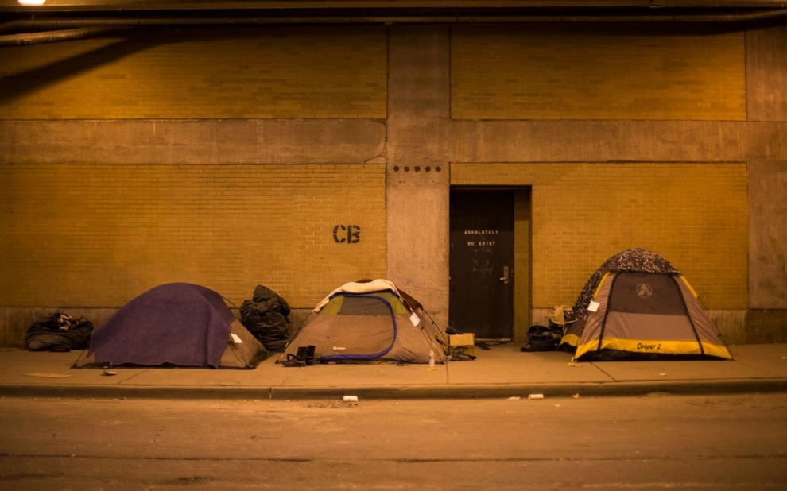
Shelter Allocation Analysis

Slide 13
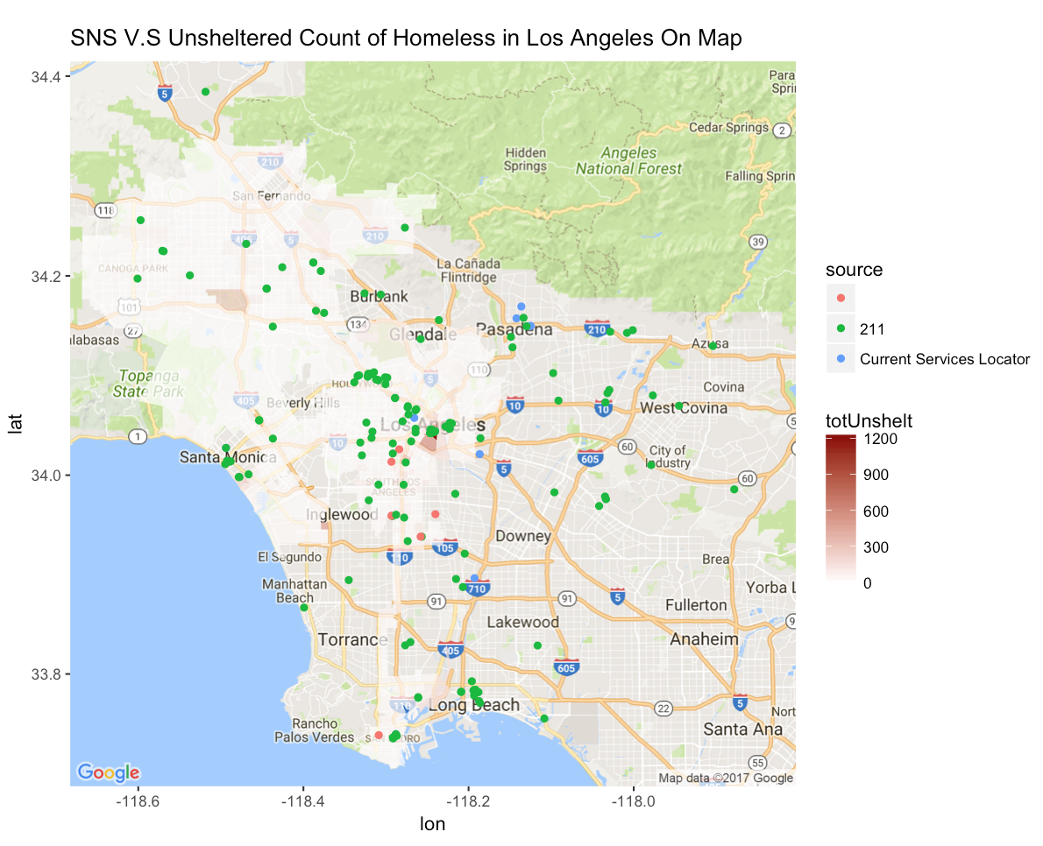
Current Shelter Location

Slide 14
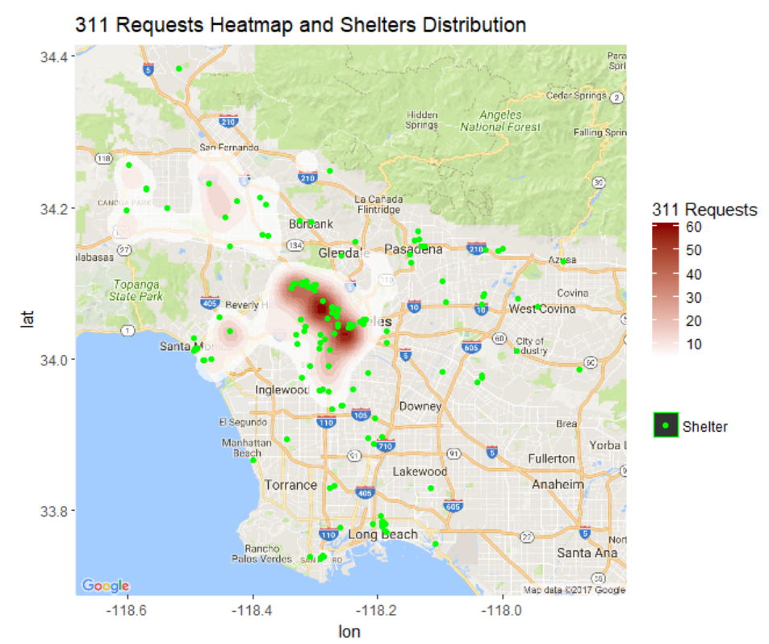
311 Requests and Shelters Allocation
Problem:
More than 20,000 of
311 request per year
Constraints:
1.Fund
2.Time
Goal:
Allocate resources
efficiently

Slide 15
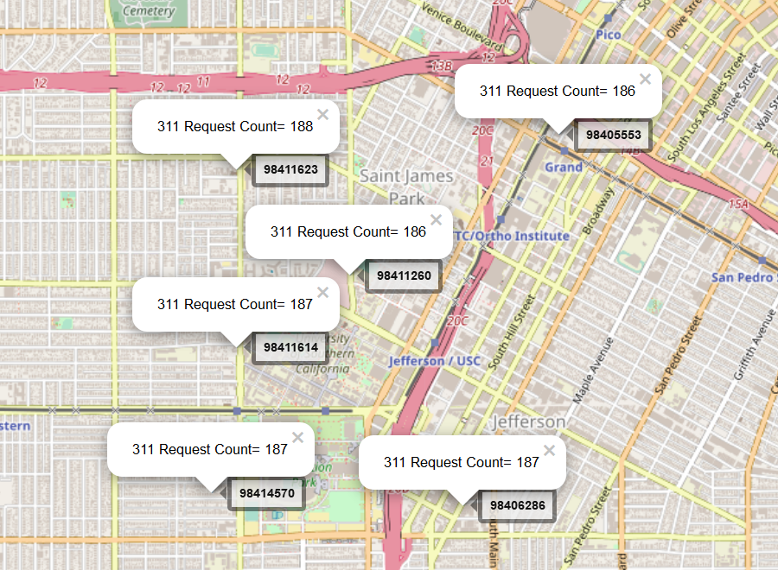
Allocation – Build Model
Assumption:
1. Each 311 call represents one homeless
2. Each 311 call report happened at the place where the homeless stay
Indicators:
1.Distance to shelters
2.Shelter Capacity
Model cons:
- Lack of info for shelters and homeless

Slide 16

Crime Analysis

Slide 17
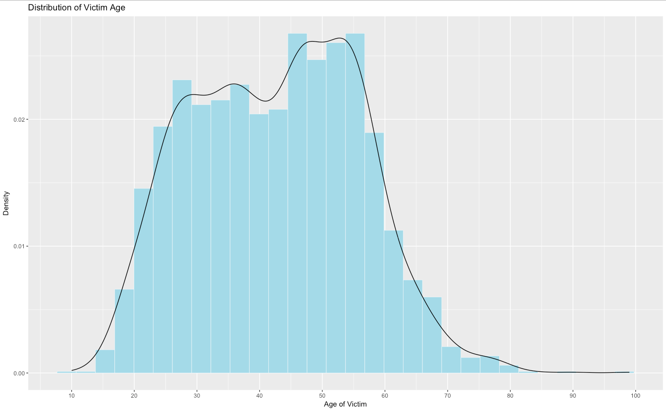
Crime—Distribution of Victim Age

Slide 18
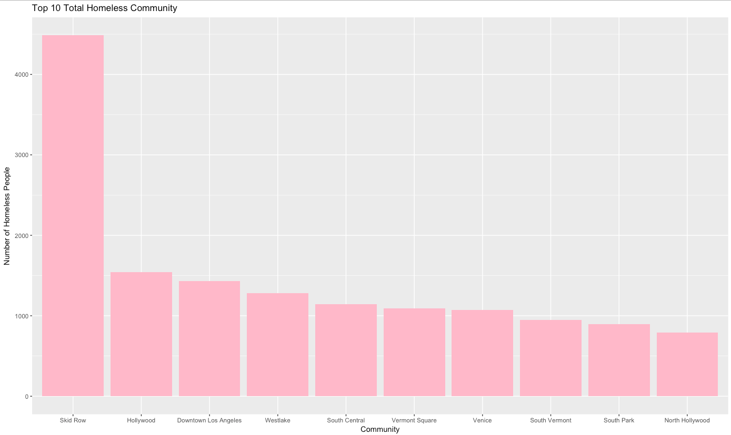
Top 10 Homeless Community

Slide 19
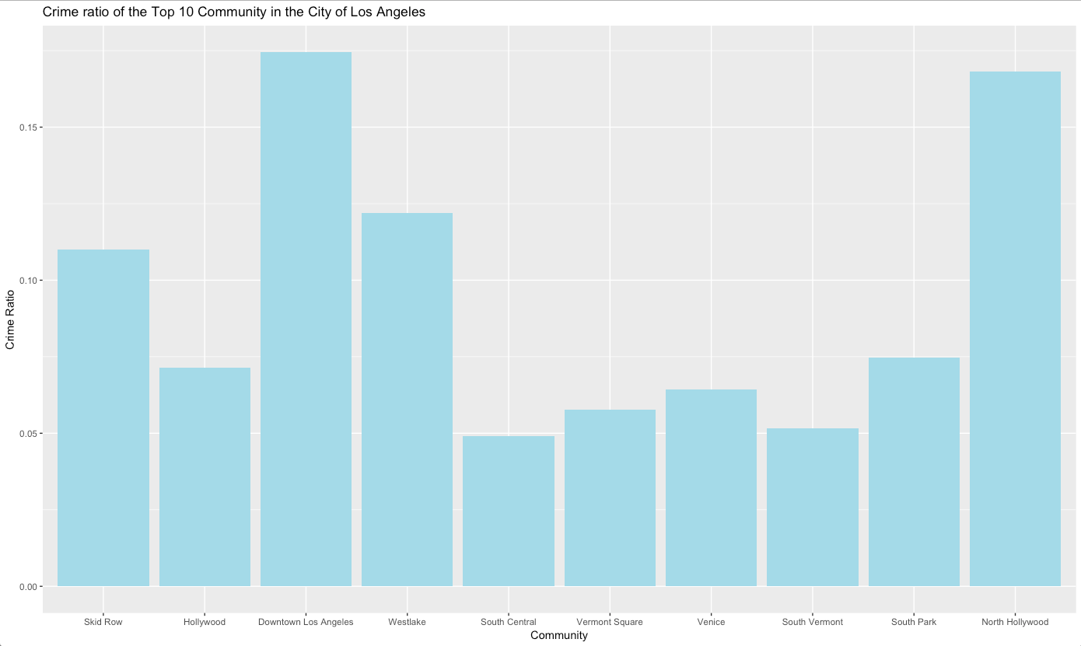

Top 10 Homeless Community
Crime ratio =
$$\frac{the number of crime}{the number of total homeless people}$$
Top 10 Homeless Community
- Crime Ratio

Slide 20
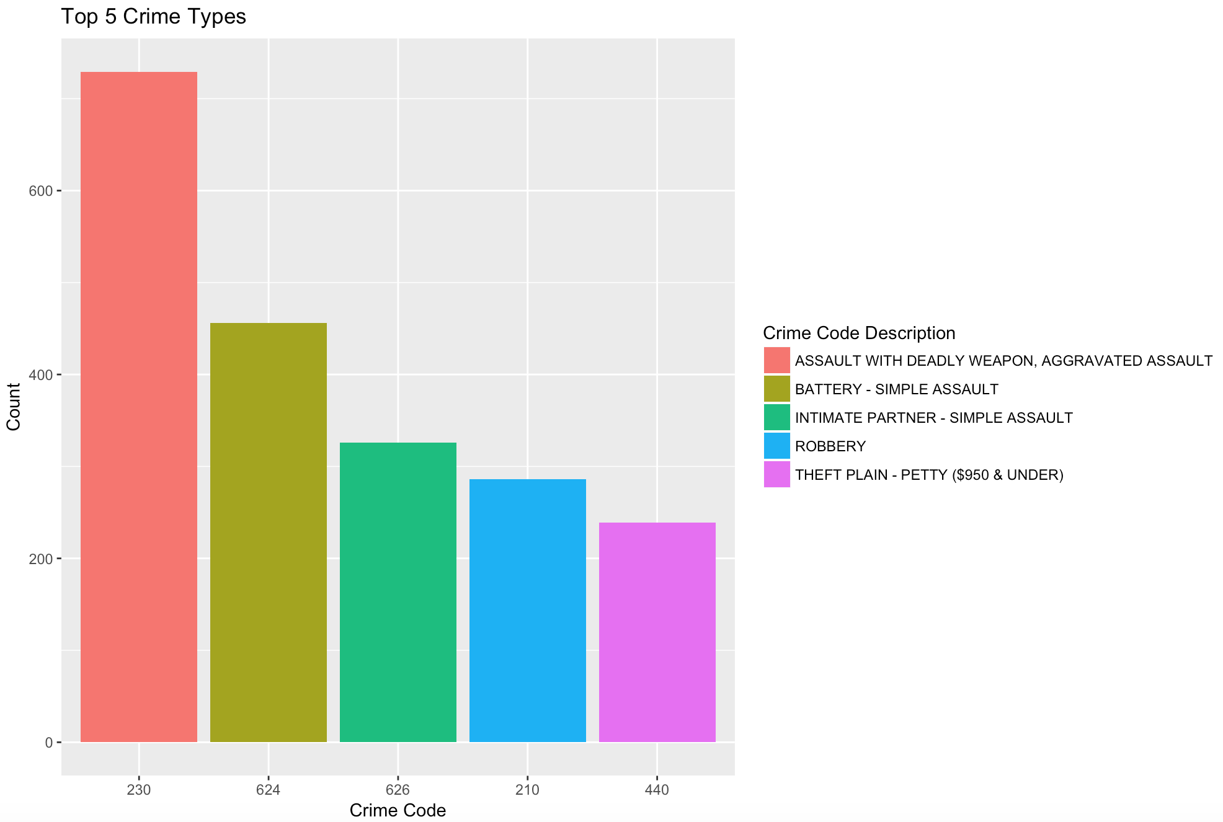
Top 5 Crime Types

Slide 21
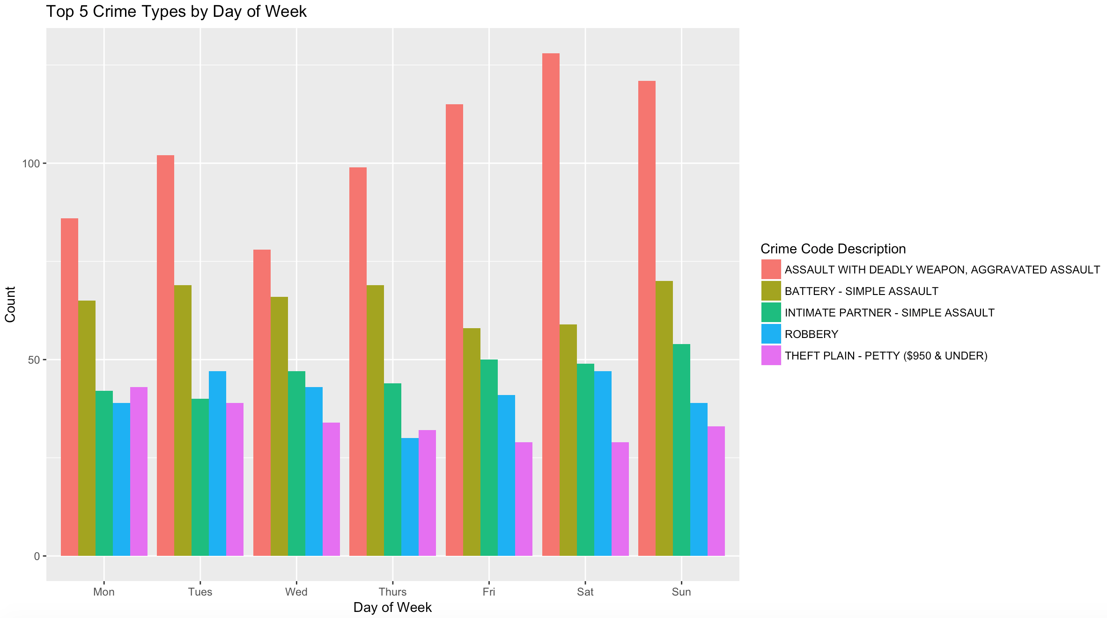
Top 5 Crime Types by Day of Week

Slide 22
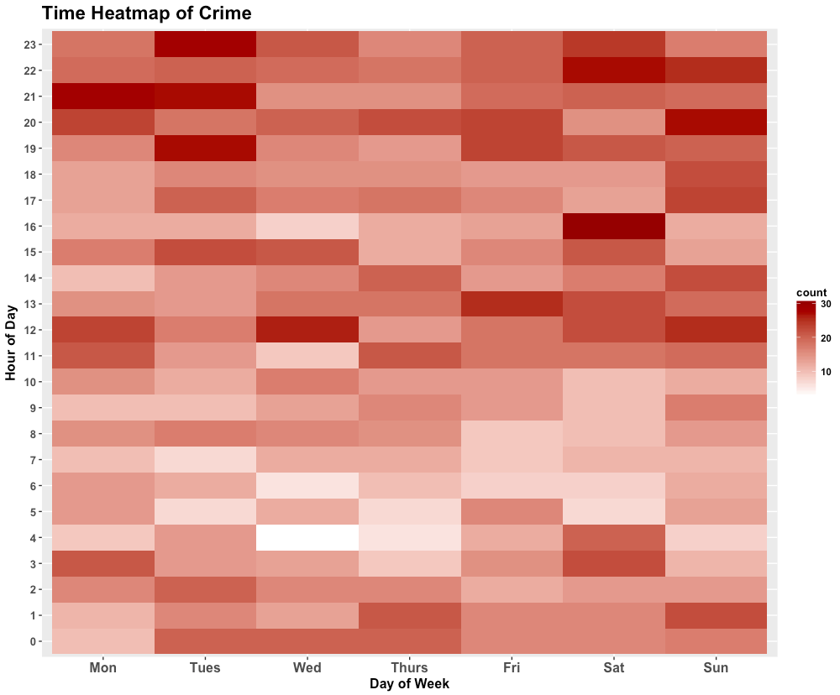
Crime Distribution by Time
A lot of crimes happen on Monday, Tuesday, Saturday, and Sunday night
A lot of crimes happen on Wednesday 12pm and Saturday 4pm
Notes:
updated

Slide 23
03
Prediction
03
-- Predict the Trend
-- Predict 2018 Top 10 Homeless Community
-- Predict 2018 Number of Crime
-- Predict 2018 Top 10 Crime Community

Slide 24
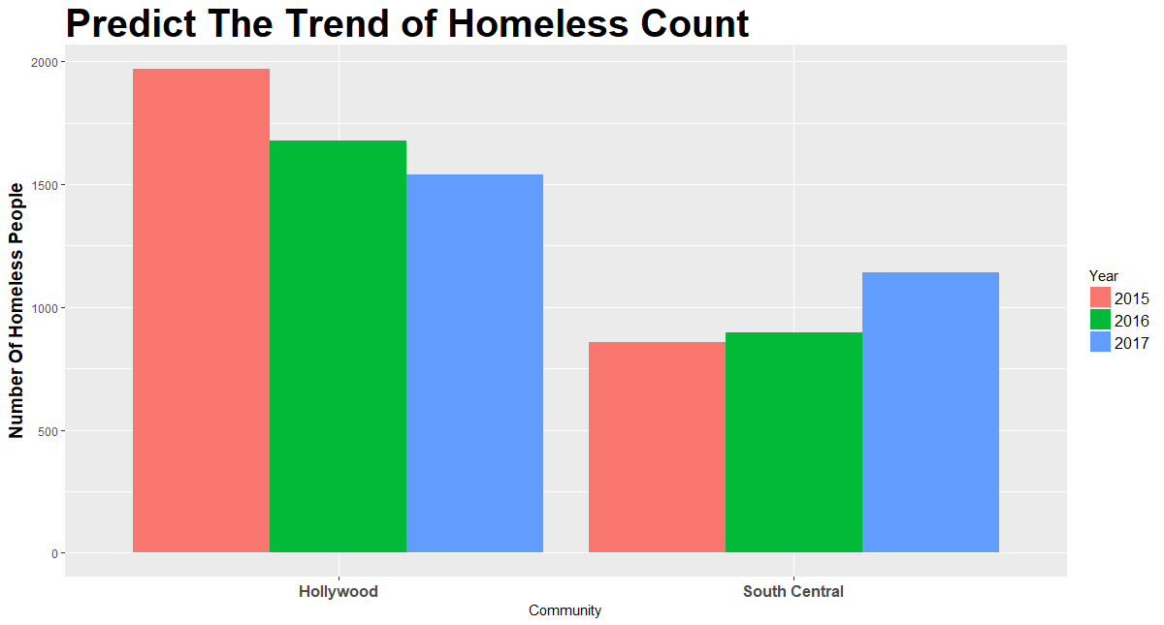
Predict The Trend

Slide 25
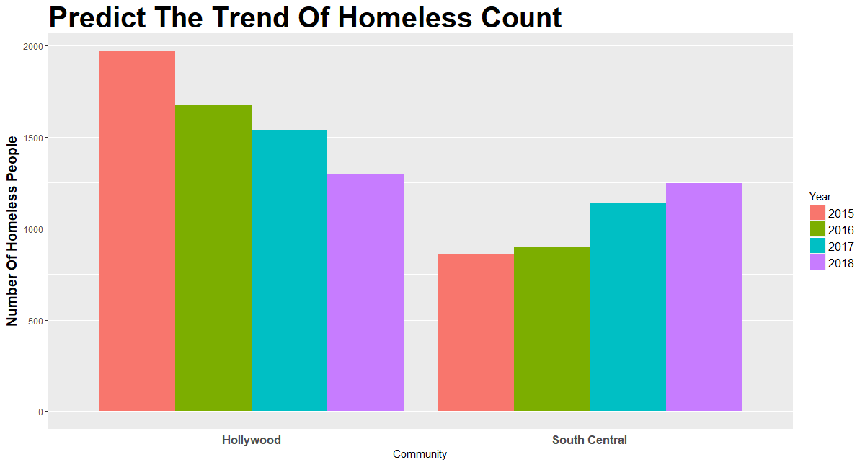
Predict The Trend

Slide 26
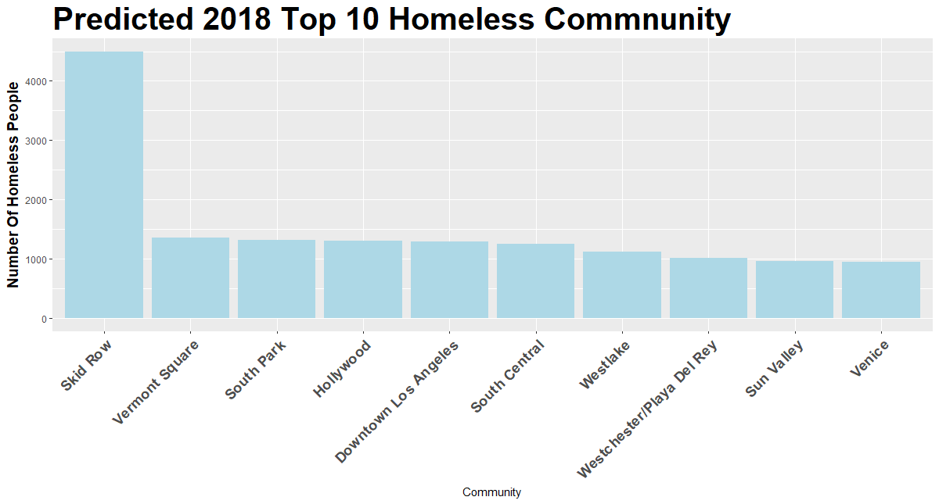
Predict 2018 TOP 10 Homeless Community

Slide 27
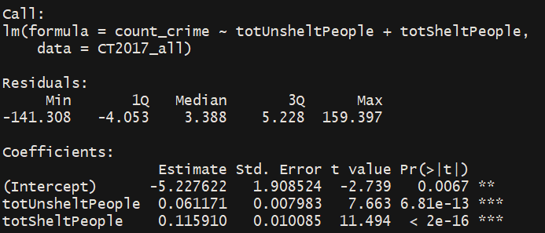
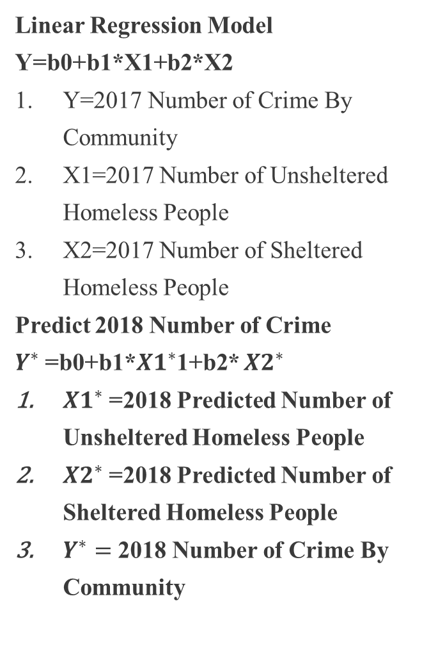
Predict 2018 Number of Crime
Linear Regression Model
Y=b0+b1*X1+b2*X2
Y=2017 Number of Crime By Community
X1=2017 Number of Unsheltered Homeless People
X2=2017 Number of Sheltered Homeless People
Predict 2018 Number of Crime
$Y^{∗}$=b0+b1*${X1}^{∗}$1+b2* ${X2}^{∗}$
${X1}^{∗}$=2018 Predicted Number of Unsheltered Homeless People
${X2}^{∗}$=2018 Predicted Number of Sheltered Homeless People
$Y^{∗}=$ 2018 Number of Crime By Community

Slide 28
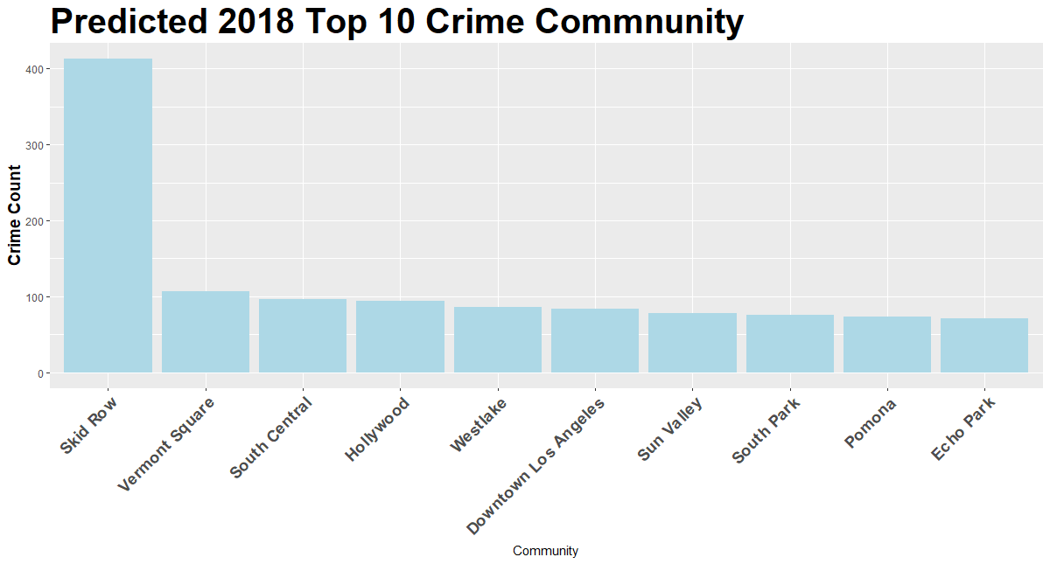
Predict 2018 TOP 10 Crime Community

Slide 29
04
Conclusion & Recommendation
04
-- Homeless Pattern
-- Crime
-- Model Building and Prediction

Slide 30
Conclusion & Recommendation
Homeless Pattern:
From 2015 to 2017, the number of homeless people is increasing
The community Skid Row is our targeted recusing area
Crime:
Have some regulation enforcement or strengthen the police in specific areas
Get more attention to Wednesday 12pm and Saturday 4pm
Model Building and Prediction:
We need more data to make precise prediction and build realistic model

Slide 31
THANK YOU !

